Slide 1
Mottled Stars - Results
How Does Starspot Coverage Affect Stellar Brightness Variability?
Miles L. Johnson, Gregory A. Feiden

Slide 2
Mottled Stars

Slide 3
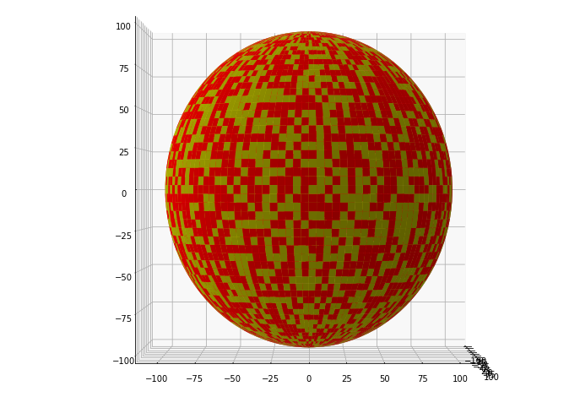
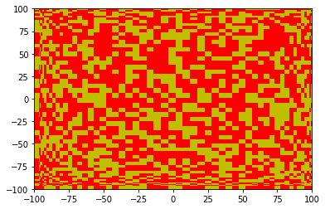
Two-Dimensional Projection
Our stellar model was divided into many small cells
Code was written that randomly selected cells to be ‘spot’ cells
We chose a projection that would conserve the apparent surface area of the cells

Slide 4
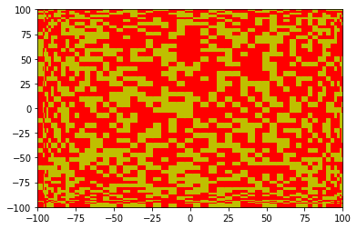
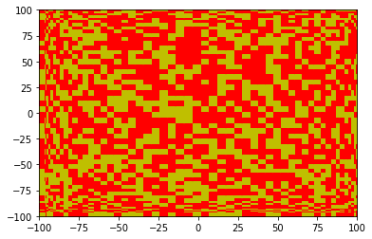

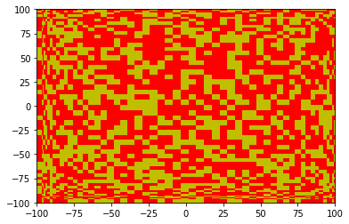

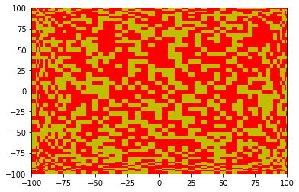
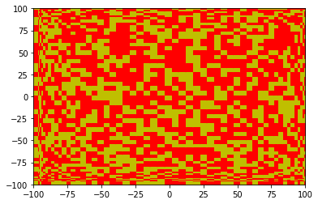

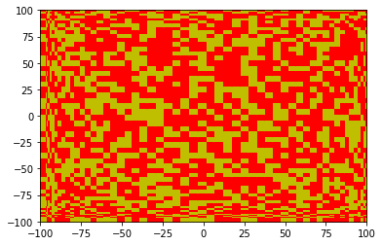
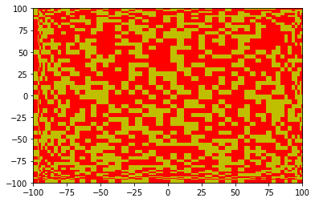
2D Projection of Rotation
We successfully coded our two-dimensional projection to rotate
This was a massive step towards integrating luminosity over time

